Slide 1

A different moneyball
Matthew Cohen
GA Data Science
4/9/2015

Slide 2

Hypothesis
Can wins in the NBA be predicted by statistics other than points scored or points allowed?

Slide 3

Background
In the movie Moneyball, the Oakland A’s chose to build their team around players that excelled in areas of the game that were not previously sought after as much as areas such as Hits and Homeruns. They had figured out that other statistics, such as On Base Percentage, were just as predictive as Hits were towards the outcome of the game, however, players who excelled in these categories cost much less to acquire. Consequently, the Oakland A’s were able to assemble a playoff caliber team for a third of the price as other teams based on the ideology that the post popular statistics may not be the most predictive.
In my project, I am looking to apply that ideology to the NBA, to investigate if there are statistics other than the most popular that predict wins.

Slide 4

Data acquisition
The data used in this project was NBA team season data from the last 40 years.
This data set was originally found as a .csv file, therefore, no web scraping was required ☺
Data set contained team season totals for statistics including Steals, Assists, Rebounds, Fouls, Free Throw Percentage…

Slide 5
Analysis #1
Linear Regression
Visualize Data
Check for perfect (or very strong) correlation
Check for heteroskedasticity, skew, colinearity...
Initial Predictive Accuracy Check

Slide 6
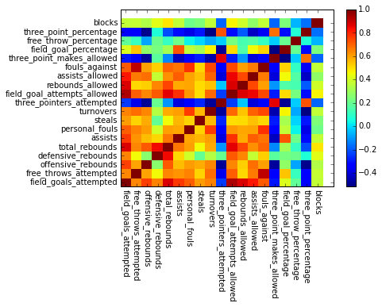

Slide 7
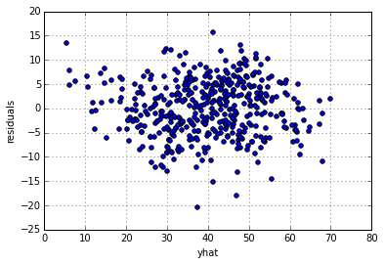

Slide 8
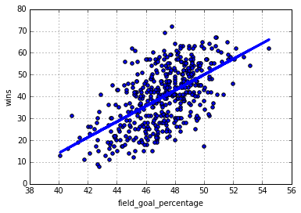

Slide 9

results
Linear Regression considering ENTIRE feature set…
R-Squared = 0.82… NOT GREAT!

Slide 10
Analysis #2
Suppose we predict, rather than wins, whether or not a team is a good team?
What is the criteria for a good team?
A team that makes the post-season (or playoffs) is generally considered a good team. As we find out in March Madness every year, once you make the playoffs, anything can happen…
50 Wins → No team has ever missed the playoffs with 50 wins or more
Good Team = 50+ wins in a season
Created categorical feature called “Good Team’

Slide 11
Analysis #2
Random Forests
Using all available statistics from the data set, can we predict whether or not a team will be a “good team”?
Find optimal number of features using RFECV
Grid search to find best parameters
Determine predictive accuracy based upon ROC/AUC score
Predict on holdout data set

Slide 12
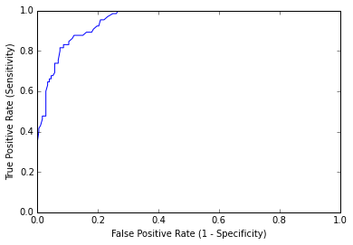
ROC/AUC
Score = 0.92

Slide 13
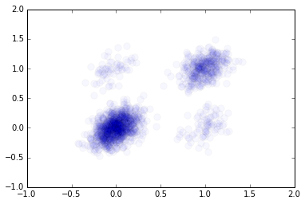
False Negatives
True Positives
Predictive Accuracy of
Full Model…
91%!
Predicted
True Negatives
False Positives
Actual

Slide 14
Analysis #3
Assists Allowed?
Personal Fouls?
Three Point Percentage?
Are there statistics in the explanatory feature set that are more predictive than others?
Can we predict whether or not a team will be a “good team” based upon much fewer statistics and still maintain good predictive accuracy? Which ones? How few?
8 features?
5 features?
Possibly 3 features???
Field Goals Attempted?
Free
Throws
Attempted?
Field
Goal
Percentage?
Assists?
Steals?
Rebounds Allowed?
Field Goal Percentage?
Total Rebounds?
Three
Pointers
Attempted?
Defensive Rebounds?
Fouls Against?
Assists?
Rebounds?
Offensive
Blocks?
Free Throw Percentage?
Turnovers?
Field Goal Attempts Allowed?

Slide 15
Analysis #3
List Feature Importances
Run RFE for specified amount of most important features
Run Random Forests Model with new subset of features

Slide 16

results
As it turns out, considering much less features, we can get close to the same predictive accuracy as the full model.
Considering 3 Statistics…
Defensive Rebounds
Assists Allowed
Field Goal Percentage
Predictive Accuracy = 84%!

Slide 17
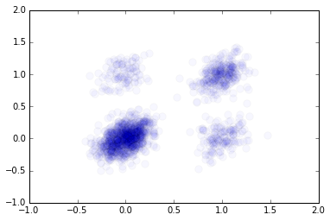
False Negatives
True Positives
Predicted
True Negatives
False Positives
Actual

Slide 18
Real world application
What conclusions can we take away from these results?
Coaching Strategy
Player Acquisition Strategy
How can the model be improved?
Consider more statistics
How is this thinking being applied in the real world?
Game by Game Analysis
Position Reclassification

Slide 19
Questions?

